Slide 1
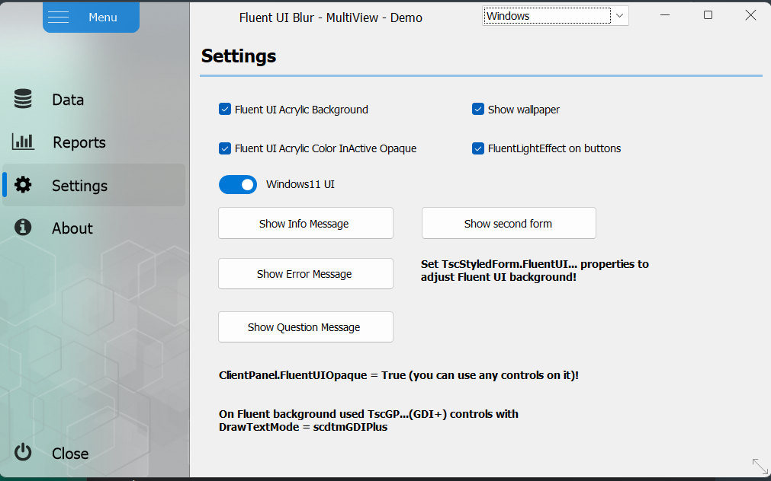
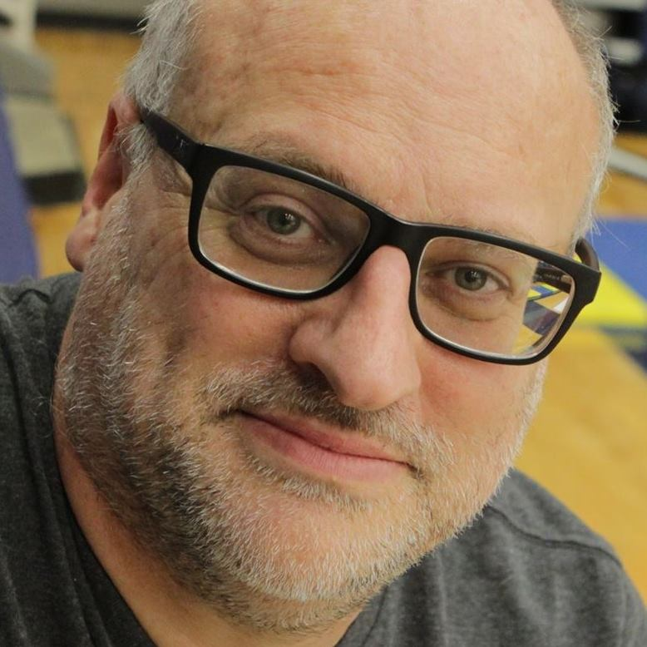

Secrets of Visual Design on Windows 11
Ian Barker
Embarcadero Delphi MVP
ian.barker@gmail.com
@punctuation about.me/IanBarker
Slides, link & replay: https://tinyurl.com/delphiw11design

Slide 2
What are we going to talk about?
Windows 11 is an evolving platform
Not everyone has it…yet 😉
RAD Studio with Delphi and the RTL has lots Windows 11 features
There are some great additional resources we can use too

Slide 3
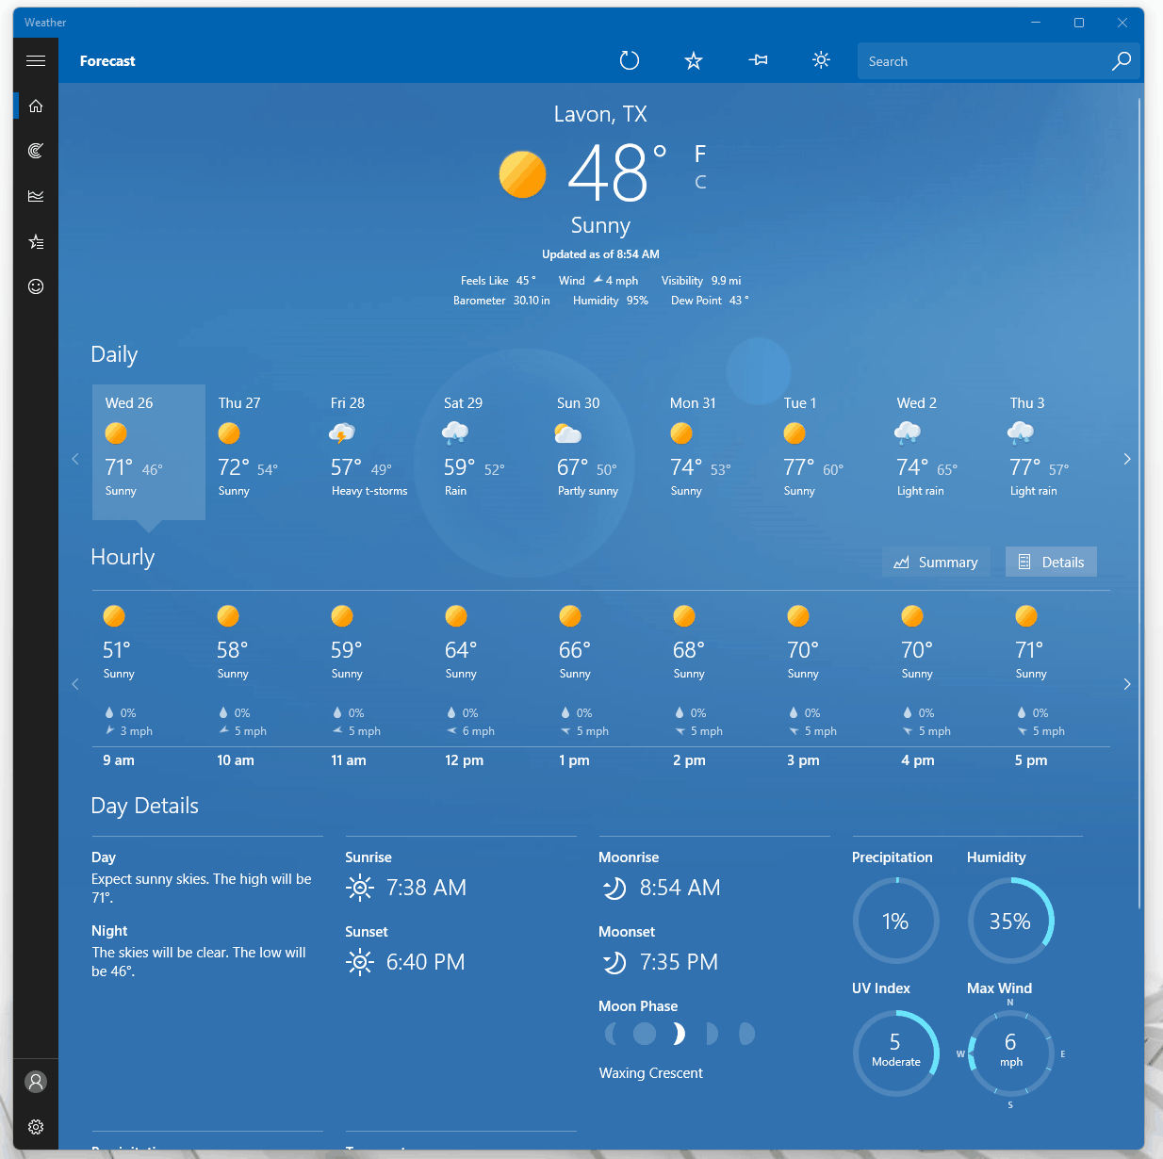
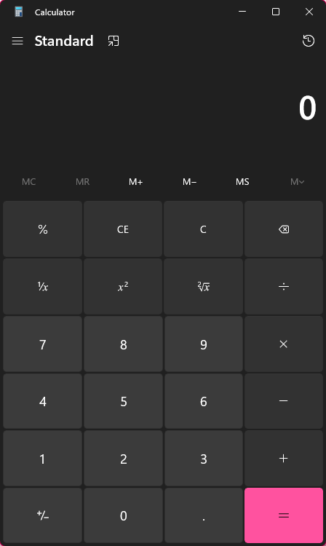
The secret wow factor apps
Two classes of app have the most attention given to their UI and UX design
Calculators and weather apps!

Slide 4
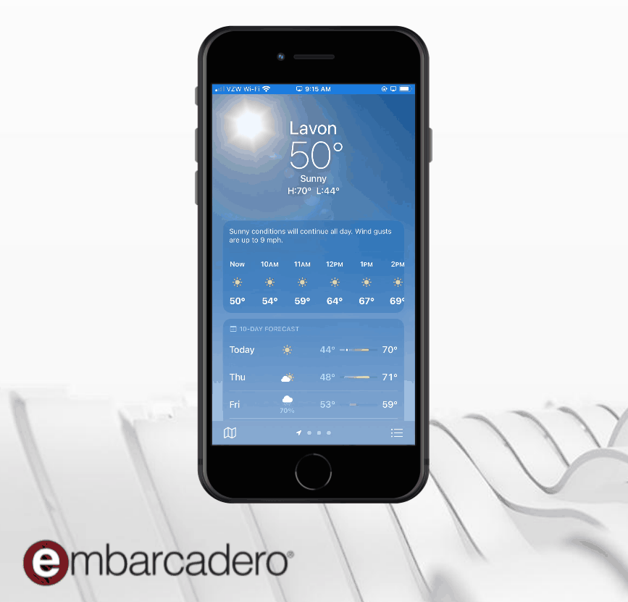
The secret wow factor apps
Both for mobile and modern desktop apps

Slide 5

All have some things in common…
On nearly all platforms the weather and calculator apps are used to showcase new ‘design language’

Slide 6

Visual Design on Windows 11
Should I use the VCL or FireMonkey FMX?
FireMonkey - cross-platform and lots of cool stuff
Works differently to VCL
Sometimes more work for Windows apps
VCL - authentic, close-to-the-metal Windows experience
Might need some extra libraries to add the extra wow

Slide 7
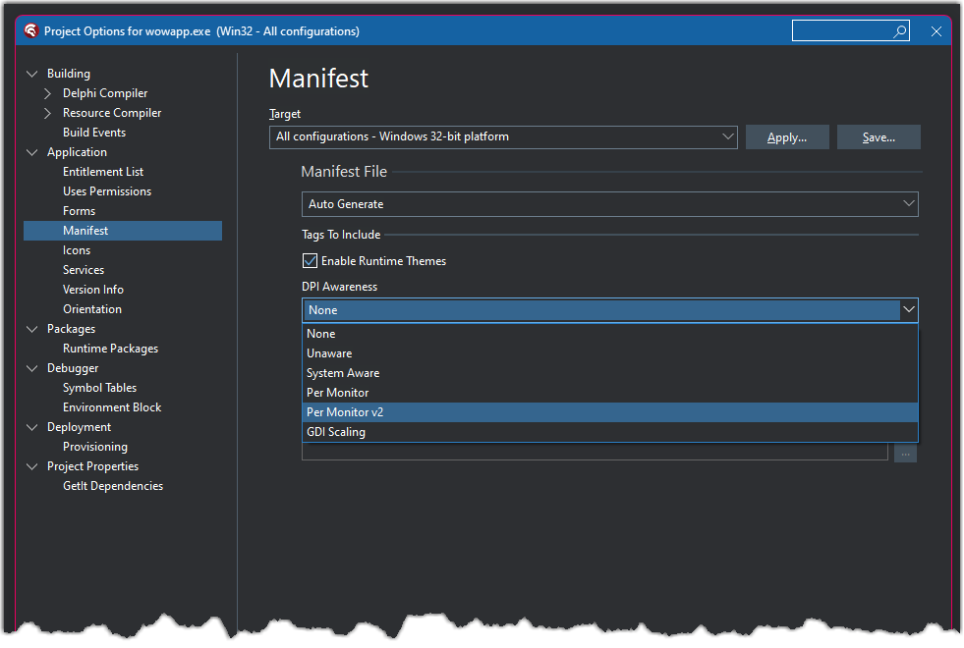
Built-in RAD Studio features
Per monitor v2
For HiDPI support is essential now

Slide 8
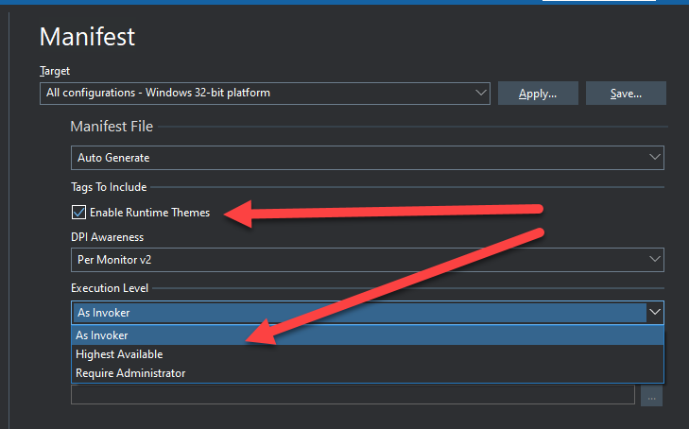
Built-in RAD Studio features
USE themes
Pick the lowest execution level you need

Slide 9
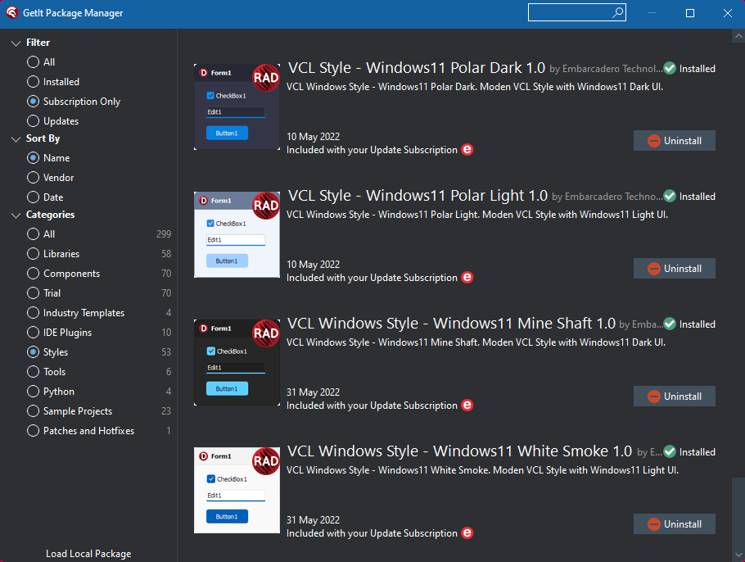
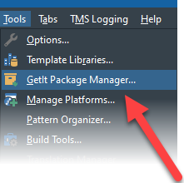
Built-in RAD Studio features
LOTS of Windows 10 and 11 specific visual styles in GetIt Package Manager

Slide 10
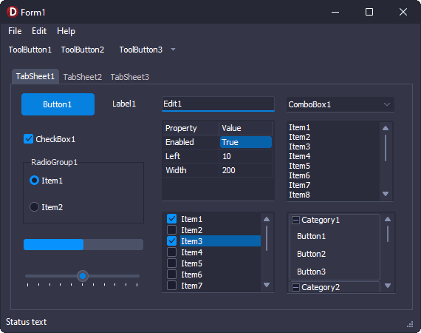
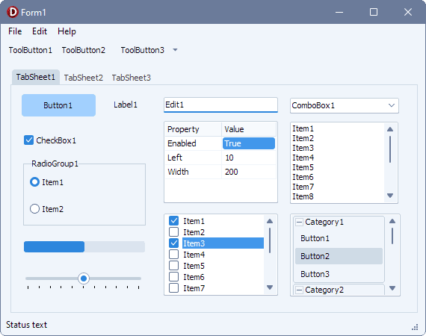
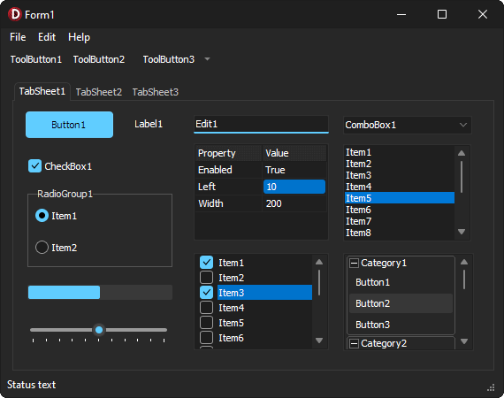
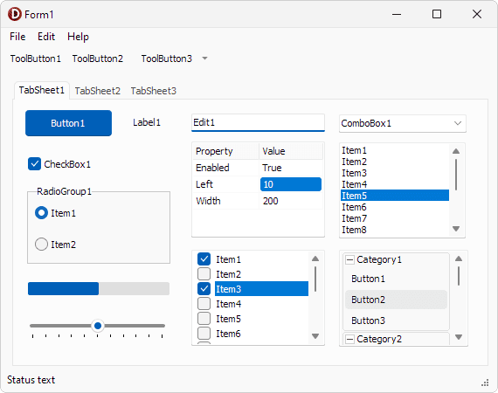
Easy boost to a Windows 11 look and feel
See Jim’s article
https://blogs.embarcadero.com/new-premium-vcl-styles-fall-2022/

Slide 11
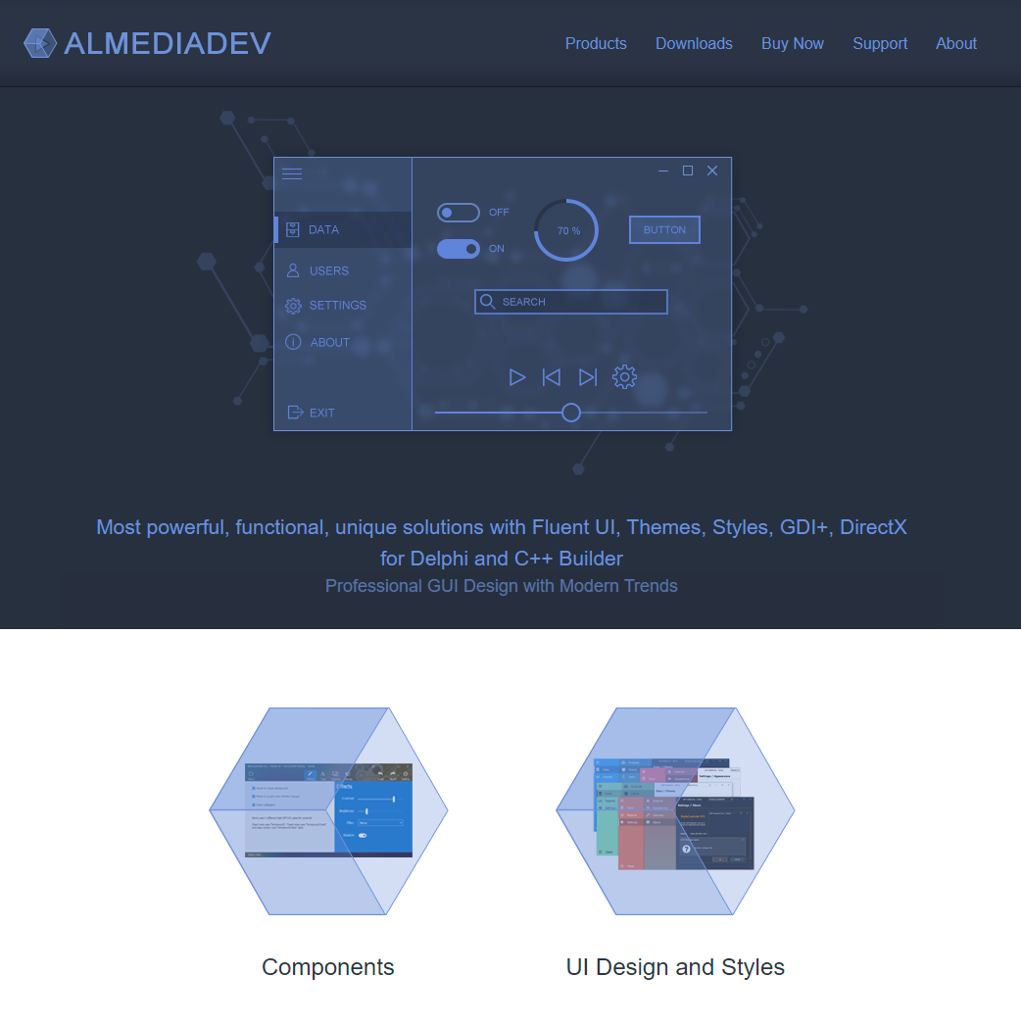
Suggested tools
Almediadev
Style controls and custom styles
https://www.almdev.com
Notes:
Support SVG, WebP, Lottie Animations, RTL text in FireMonkey. One customer complained that they were only able to get 1000 fps for a FULL SCREEN animation - lol (100fps without Skia4Delphi). Spirit of Delphi 2021 winners.

Slide 12
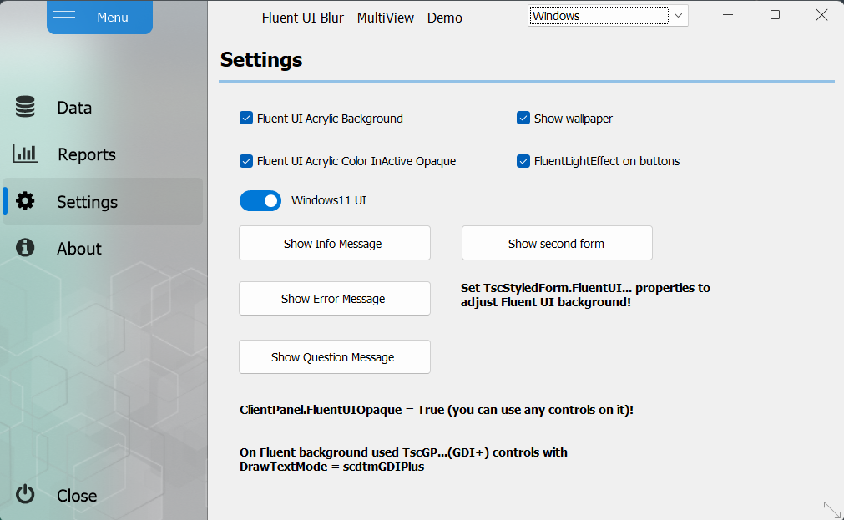
Almediadev Style Controls
Full support of Fluent UI features such as ‘acrylic background’
Notes:
Support SVG, WebP, Lottie Animations, RTL text in FireMonkey. One customer complained that they were only able to get 1000 fps for a FULL SCREEN animation - lol (100fps without Skia4Delphi). Spirit of Delphi 2021 winners.

Slide 13
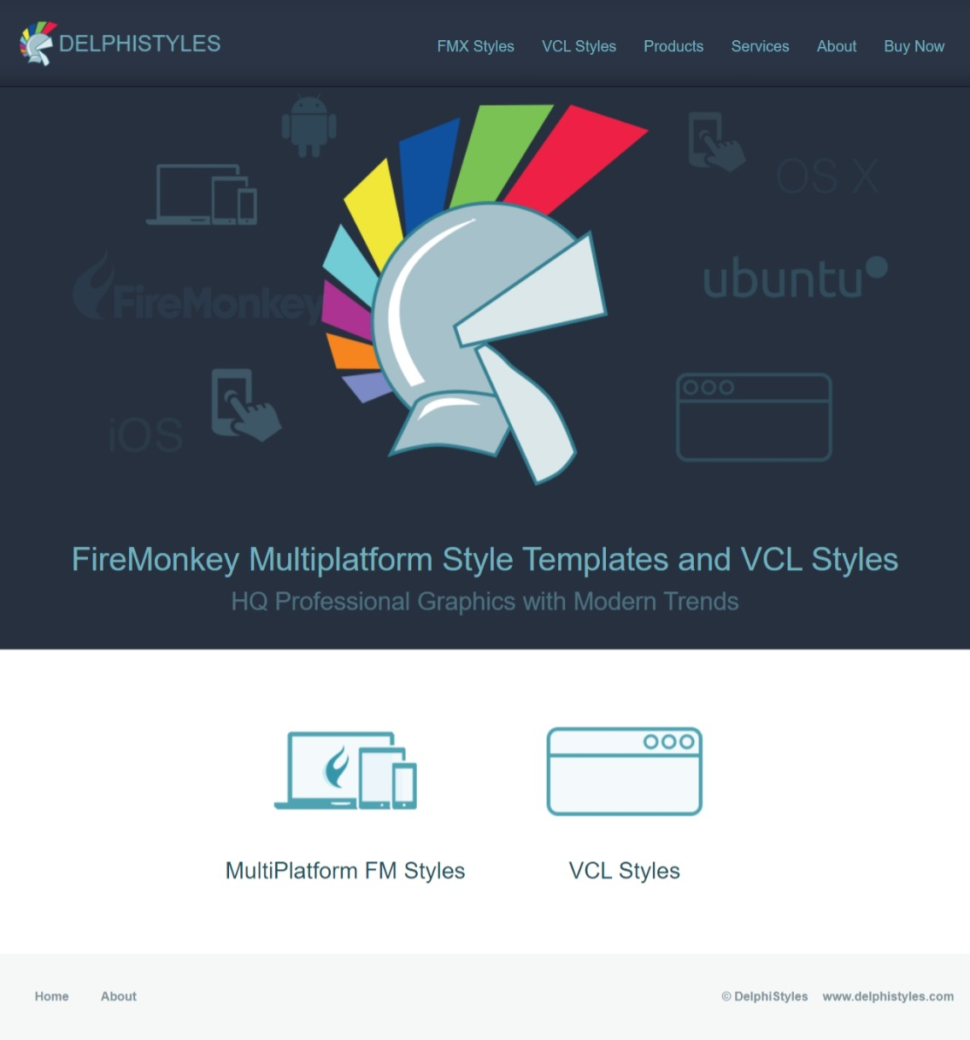
Delphi Styles site
Many more custom styles for VCL and FMX
delphistyles.com
Notes:
Support SVG, WebP, Lottie Animations, RTL text in FireMonkey. One customer complained that they were only able to get 1000 fps for a FULL SCREEN animation - lol (100fps without Skia4Delphi). Spirit of Delphi 2021 winners.

Slide 14
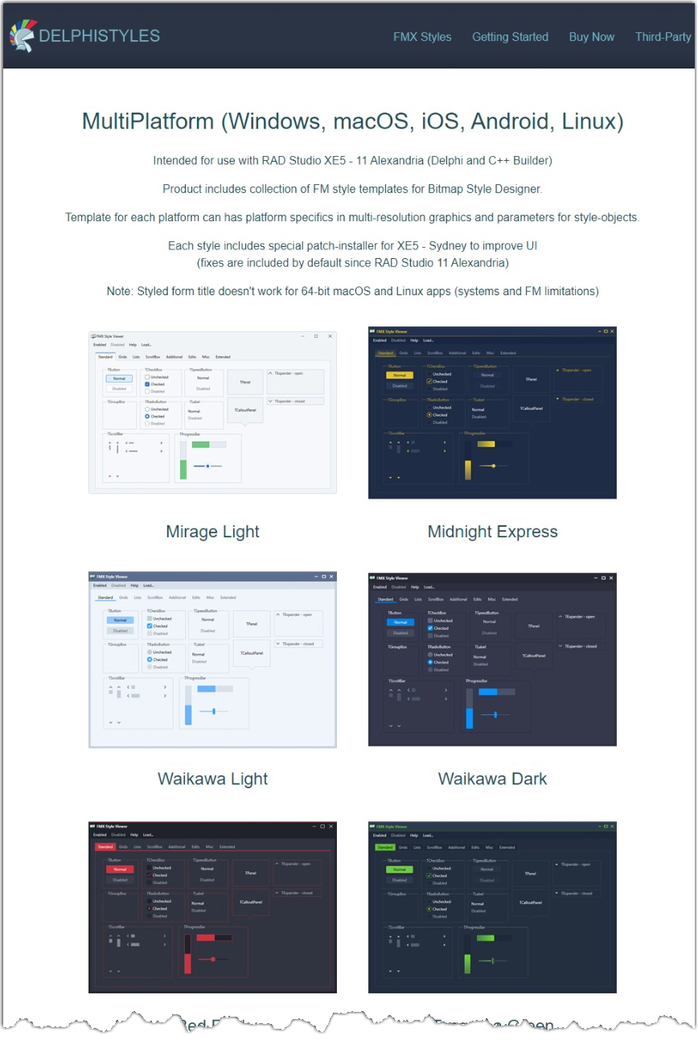
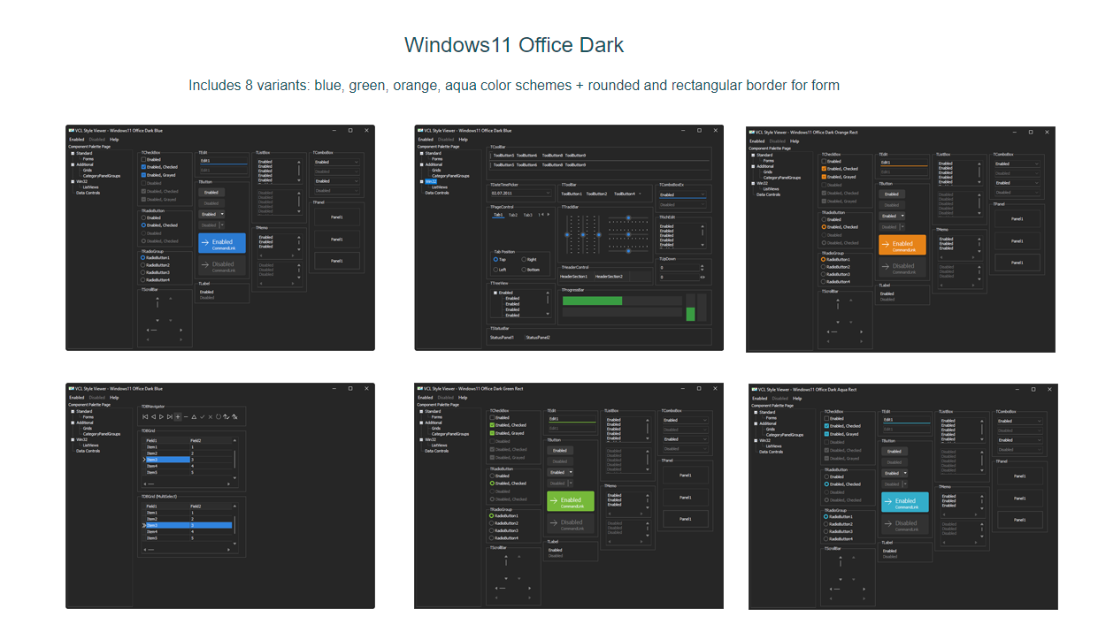
Delphi Styles site
Notes:
Support SVG, WebP, Lottie Animations, RTL text in FireMonkey. One customer complained that they were only able to get 1000 fps for a FULL SCREEN animation - lol (100fps without Skia4Delphi). Spirit of Delphi 2021 winners.

Slide 15

Suggested tools
Turbocharge your FireMonkey and VCL apps
https://www.skia4delphi.org
Notes:
Support SVG, WebP, Lottie Animations, RTL text in FireMonkey. One customer complained that they were only able to get 1000 fps for a FULL SCREEN animation - lol (100fps without Skia4Delphi). Spirit of Delphi 2021 winners.

Slide 16
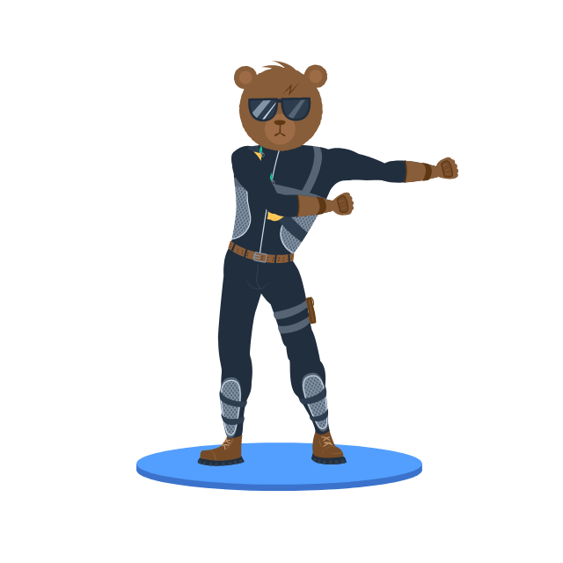
Adding some wow
Good sources for FREE resources
www.svgrepo.com
300,000 free SVGs!
lucide.dev
Every kind of icon, open source and free
lottiefiles.com
Free lottie animations (works with Skia4Delphi)

Slide 17

Secrets of Visual Design on Windows 11
Demo time!
Ian Barker
Embarcadero Delphi MVP
ian.barker@gmail.com
@punctuation about.me/IanBarker

Slide 18
Secrets of Visual Design on Windows 11
Other resources
DelphiDarkMode
https://github.com/checkdigits/delphidarkmode
Blog posts by me
https://blogs.embarcadero.com/author/ianbarker/

Slide 19

Secrets of Visual Design on Windows 11
Ian Barker
Embarcadero Delphi MVP
ian.barker@gmail.com
@punctuation about.me/IanBarker
Links from this webinar
https://gist.github.com/checkdigits/public
Slides, link & replay: https://tinyurl.com/delphiw11design

